Slide 1
Jenkins Automation Tool Integration Introduction
by James/Vivian
2015-08-28

Slide 2
Agenda
What is Jenkins
Jenkins Feature
Jenkis Job List/View
Jenkins Job Monitor

Slide 3

Overview to Jenkins Tool
What is Jenkins
  Building/testing software projects continuously
  Monitoring executions of externally-run jobs

Slide 4
Features
What in Jenkins
  Easy installation/Configuration, java based war deployment
  CVS/Subversion integrations
  Email/RSS/IM integration
  Junit/TestNG test reports
  Distributed builds
  File fingerprinting
  Plug-in Support(Groovy/AJAX/Jelly/Python)

Slide 5
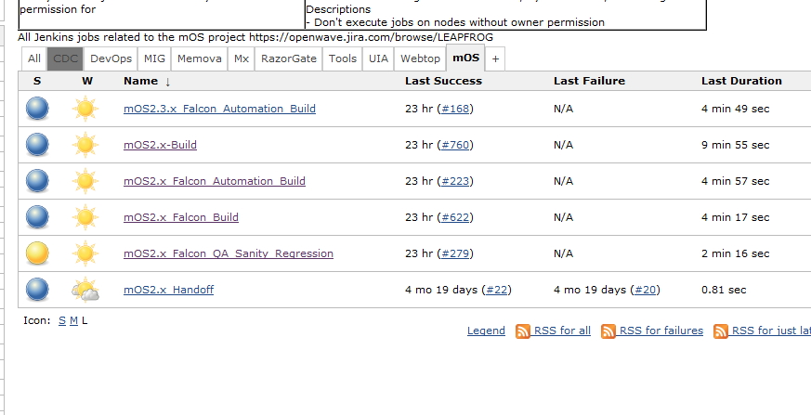
Jenkins Job List/View management
Jenkins job/build

Slide 6
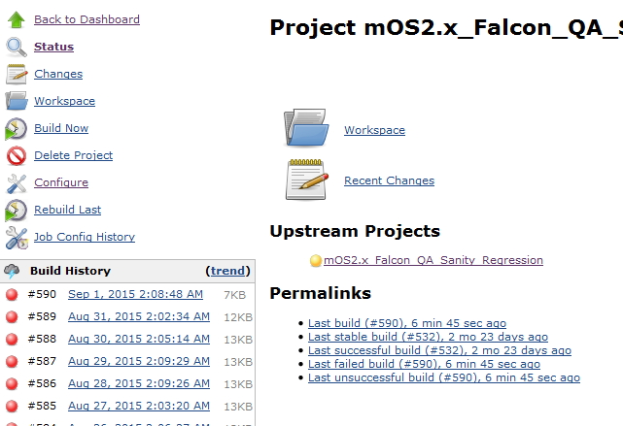
Job Monitor (Pass/Fail/Error/Abort/Rebuild)

Slide 7
Jenkins Job Details
Project Name/Description
Target Machine
Source code control(CVS, GIT)
Build triggers: Daily timer, File change, folder change
Build steps: SSH, Shell, Window Shell, Ant Job, Custom

Slide 8
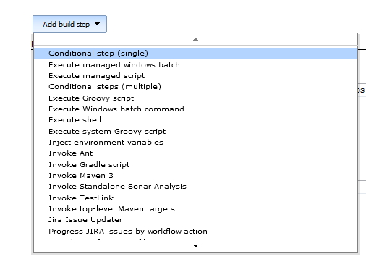
Build Steps

Slide 9
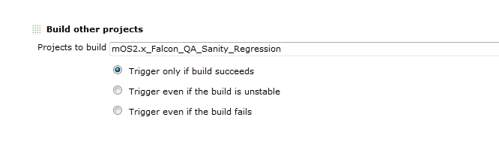
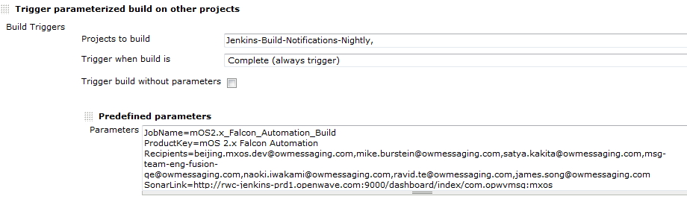
Post Build Actions Part I

Slide 10
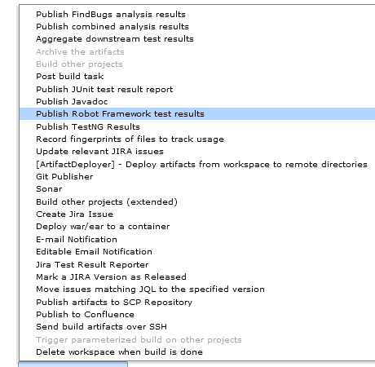
Post Build Actions Part II

Slide 11
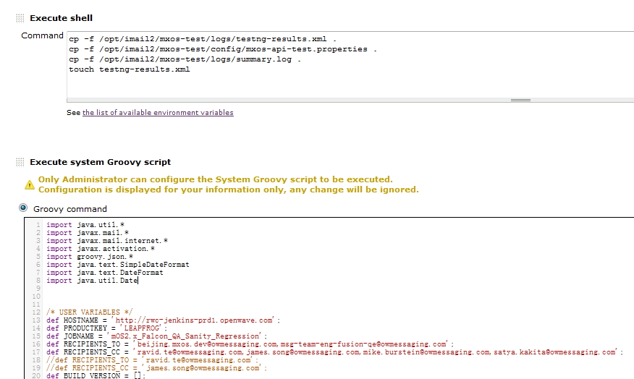
Groovy Script Sample (mOS2.x_Falcon_QA_Sanity_Regression_Reporter)

Slide 12
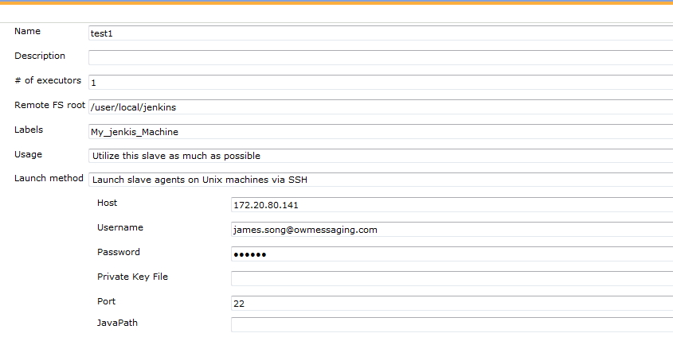
Slave Machine Management

